Slide 1
CI/CD

Slide 2
What’s Continuous Integration
The main point of continuous integration is to detect errors as early as possible in build process.
Continuous integration puts a great emphasis on testing automation to check that the application is not broken whenever new commits are integrated into the main branch.

Slide 3
Continuous Delivery
Continuous delivery is an extension of continuous integration. Continuous Delivery ensures that the code is ready and can be delivered at any time.

Slide 4
Continuous Deployment
Continuous deployment is very similar to Continuous delivery. The only difference is that continuous delivery require manual deployment (or more specifically approval).

Slide 5
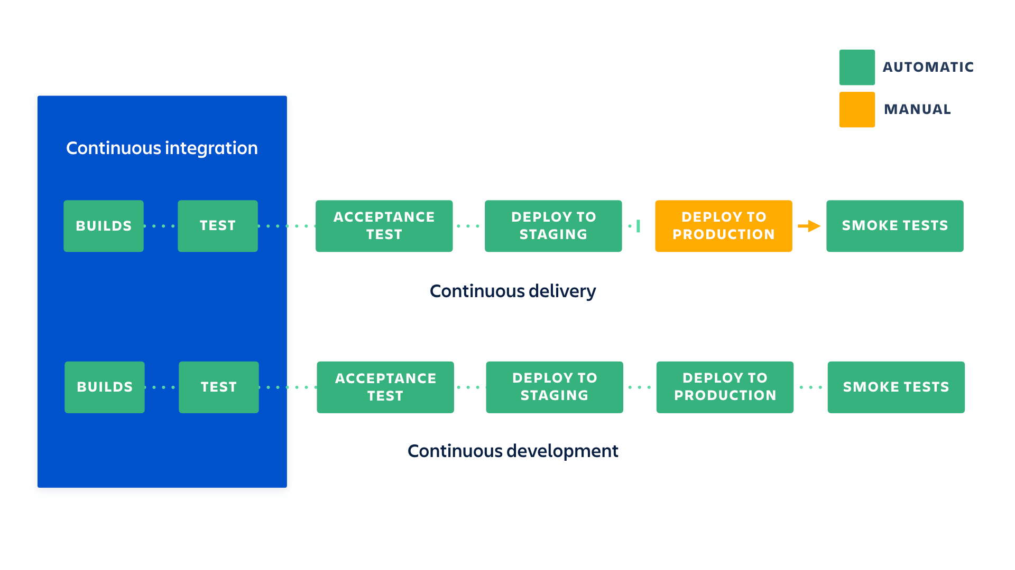

Slide 6
Github action
It’s a tool maintained by Github that you can use to develop a concrete pipelines.
With github actions you can develop your CI/CD pipelines

Slide 7
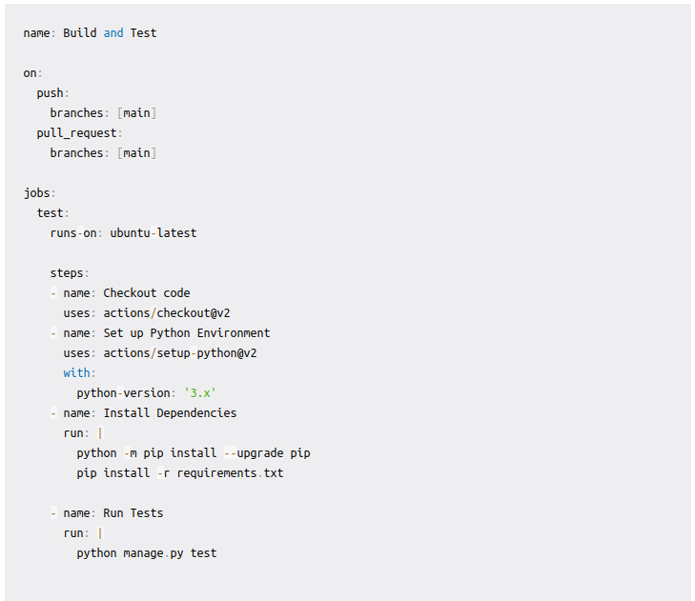
CI Example
This pipeline will be triggered after any pull request to the main branch or any commit to the main branch
The target of this pipeline is to run some tests and make sure it’s passing correctly.

Slide 8
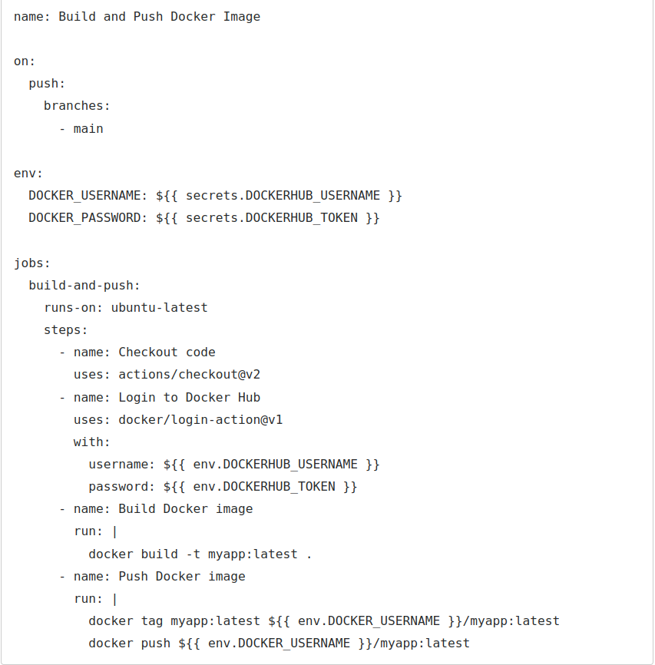
CD Example
This is a pipeline to build and push a docker image to docker hub image registry

